Slide 1
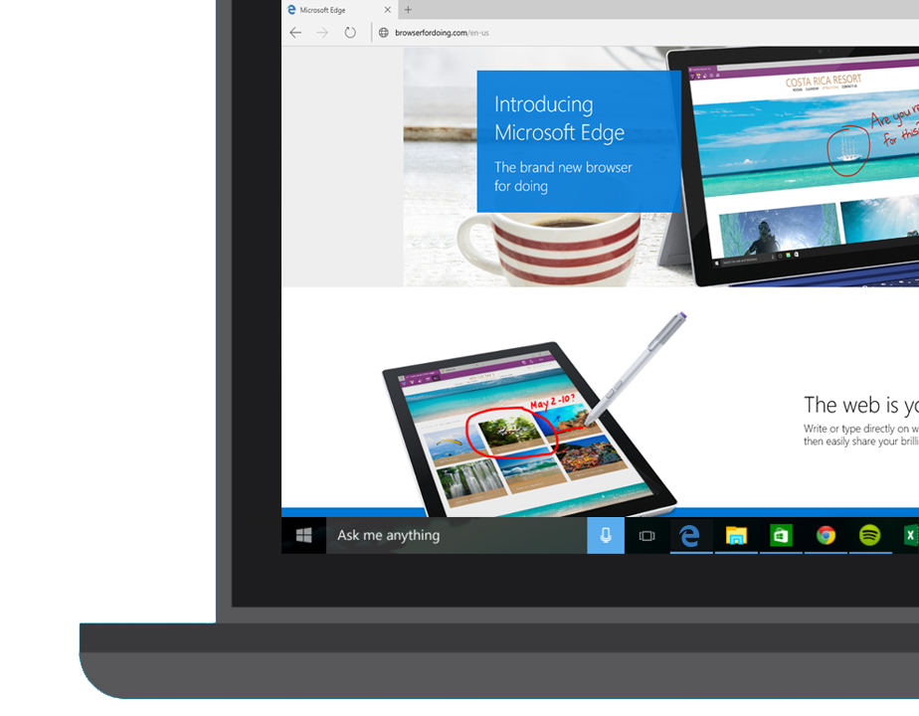
Microsoft Edge and Web App Platform

Slide 2
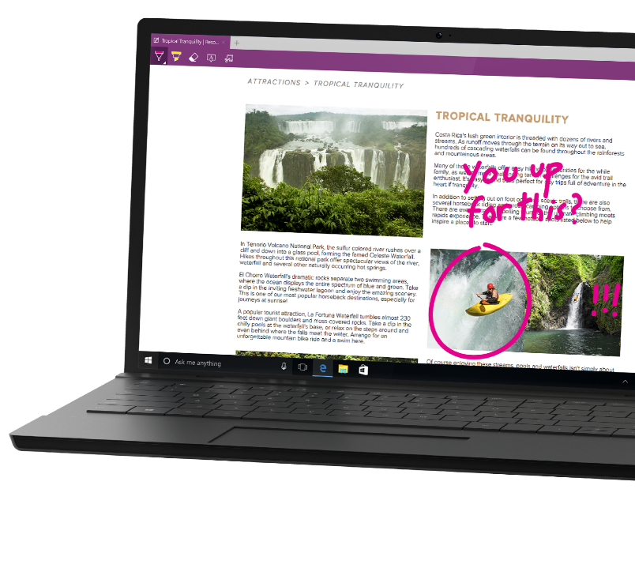
What is Microsoft Edge?
Notes:
Let’s start by talking about the web engine, Microsoft Edge.
Edge is at the heart of our web platform, both in displaying web content but also at the heart of web apps.

Slide 3
44 Billion
Web sites
Notes:
There are 44 Billion web sites out there, so when you set out to build a web browser, you have to aim to support all 44 Billion of those websites. This is why creating a great web browser is actually pretty hard.

Slide 4
Trillions
of URLs crawled every day
Notes:
Another big number: there are trillions of URLs that our Bing web crawlers visit literally every day, in order to ensure that our new web browser is compatible with the world wide web.

Slide 5
1995
2015
1
2
3
4
4.x
5
5.5
6
7
8
9
9
10
11
Trident
Notes:
Before we talk some more about Microsoft Edge, let’s take a look at the history behind it.
We released the first version of Internet Explorer in 1995 along with Windows 95.

Slide 6

HTML4, ES3, CSS2
1995
1995
2015
1
2
3
4
4.x
5
5.5
6
7
8
9
9
10
11
Trident
Quirks
Strict
!DOCTYPE
Notes:
This was followed by a number of other versions until we got to IE6, which was the first version to have the dual engine, in other words the document type.
At this time the goal was to maintain backwards compatibility with what we had before, and at the same time introduce new features.
So this is where we introduced the DOCTYPE, which you can think of as a big IF inside your code. If you are in Quirks mode you get the new features, and if you are in Strict mode, you are compatible with what we had before.

Slide 7

HTML4, ES3, CSS2
CSS2.1
1995
2015
1
2
3
4
4.x
5
5.5
6
7
8
9
9
10
11
Trident
!DOCTYPE
IE5
Quirks
IE7
Compatibility View
IE8
Standards Mode
x-ua-compatible
Notes:
This was a time when the pace of change of the web was not as great as it is today.
So we stuck with IE6 for quite a while, and then eventually released IE7 and then IE8.
At that time it was considered OK for the browser to effectively support three different modes: the IE5 Quirks mode, IE7 mode and IE8 mode.

Slide 8

HTML5, SVG, ES5
HTML4, ES3, CSS2
CSS2.1
1995
2015
1
2
3
4
4.x
5
5.5
6
7
8
9
9
10
11
Trident
IE5
Quirks
IE7
Compatibility View
IE8
Standards Mode
!DOCTYPE
x-ua-compatible
IE9
Standards Mode
Notes:
With IE9, we introduced a fourth engine, supporting many new features such as HTML5, SVG, EcmaScript 5.
By this time, your website code began to getting a little bit untidy, with if IE5…. If IE7… If IE8…. If IE9….

Slide 9
HTML5, SVG, ES5, CSS3
HTML4, ES3, CSS2
CSS2.1
1995
2015
1
2
3
4
4.x
5
5.5
6
7
8
9
9
10
11
Trident
IE5
Quirks
IE7
Compatibility View
IE8
Standards Mode
!DOCTYPE
x-ua-compatible
IE9
Standards Mode
QME
Quirks Mode Emulation
IE10
Standards Mode
Notes:
But the approach now was the same as it had always been – provide backward compatibility with what had been before, but also introduce a new version supporting new features.

Slide 10
Modern Web
HTML5, SVG, ES5, CSS3
Legacy Web
CSS2.1
HTML4, ES3, CSS2
1995
2015
1
2
3
4
4.x
5
5.5
6
7
8
9
9
10
11
Trident
IE5
Quirks
IE7
Compat View
IE8
Standards Mode
EMIE
Enterprise Mode
!DOCTYPE
x-ua-compatible
IE9
Standards Mode
IE10
Standards Mode
QME
Quirks Mode Emulation
IE11
Standards Mode
Notes:
And guess what, by the time we got to IE11, we realized that we had to do something.
The approach we had been following has by now resulted in 8 engines inside IE and this approach is just not viable anymore.

Slide 11
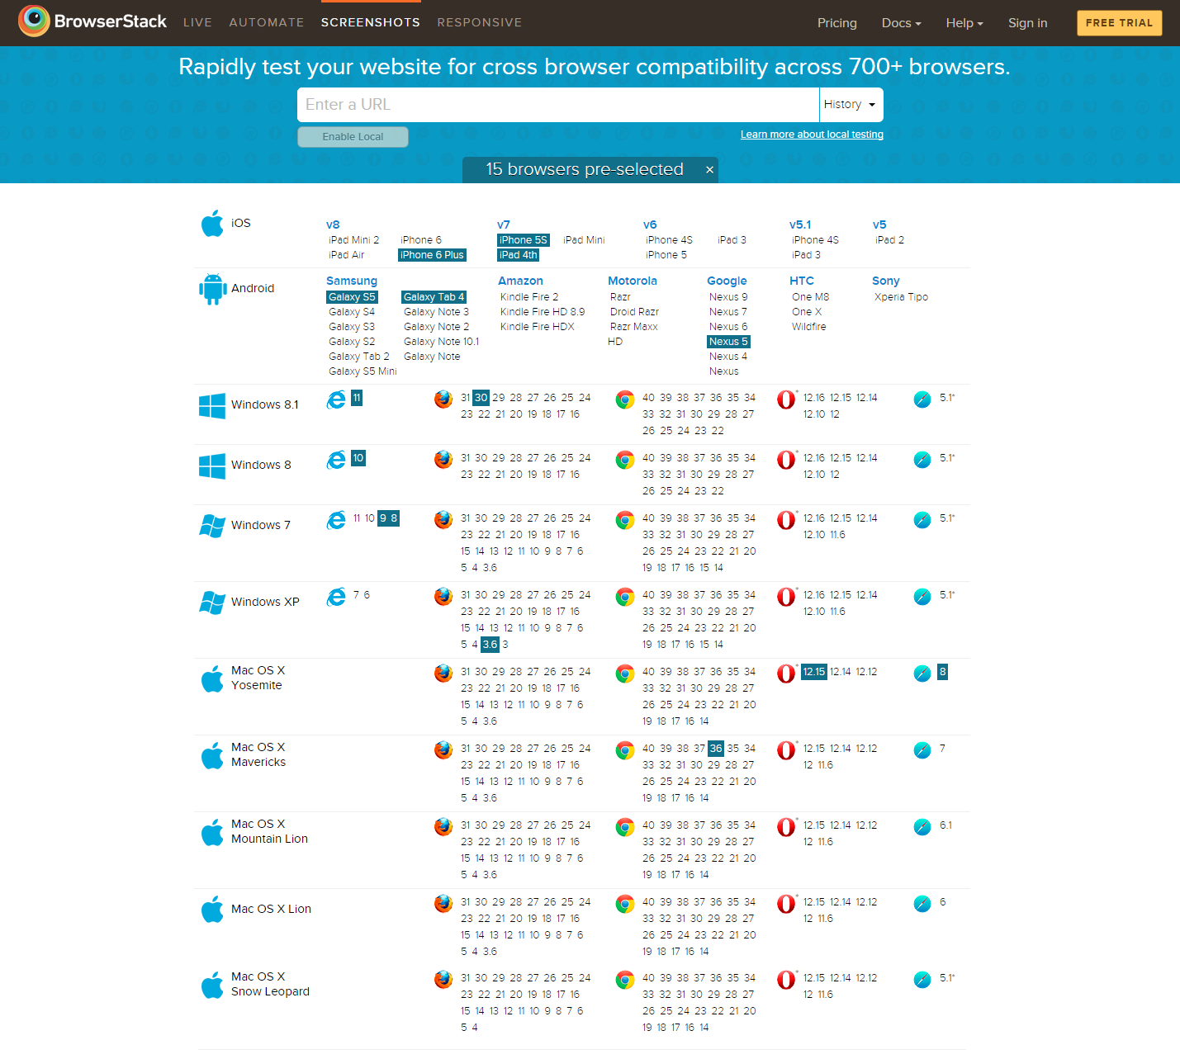
Notes:
At the same time, other approaches were being followed elsewhere in the industry.
This table represents all the different browser versions, and in the same timeframe that IE went from IE 1 to IE 11, Chrome for example went through very many versions, from version 1 to version 40.
The only difference is that with each new version, they removed support for the previous version. They did not support backwards compatibility, so that with the release of a new version, perhaps some feature from earlier gets removed, and some websites that used it get broken. But that’s considered OK and how the web should work with a modern browser.

Slide 12
Mobile Chromium usage across forks
Chromium 28 – 27%
Chromium 33 – 6%
Chromium 35 – 1%
Chromium 38 – 1%
Chromium 40 – 39%
Chromium versions
<10
Chromium 39 – 3%
Chromium 37 – 2%
Chromium 30 – 1%
Chromium 30 – 18%
Chromium 18 - 2%
Source: www.quirksmode.org/blog/archives/2015/02/counting_chromi.html
Notes:
So this produced some issues as well.
With IE we had problems, because the web developer had to support IE6, IE7, IE8 and so on.
But with Chromium for example, a very widely used browser on the mobile side, they had their own problems. As you can see here, the number of different versions of chromium that are out there in the wild at any particular time can be high, as they could not control which versions of the browser is being used on all the different devices out there. So you get a lot of fragmentation.
So this was a problem for IE, and a problem for all modern browser vendors.

Slide 13
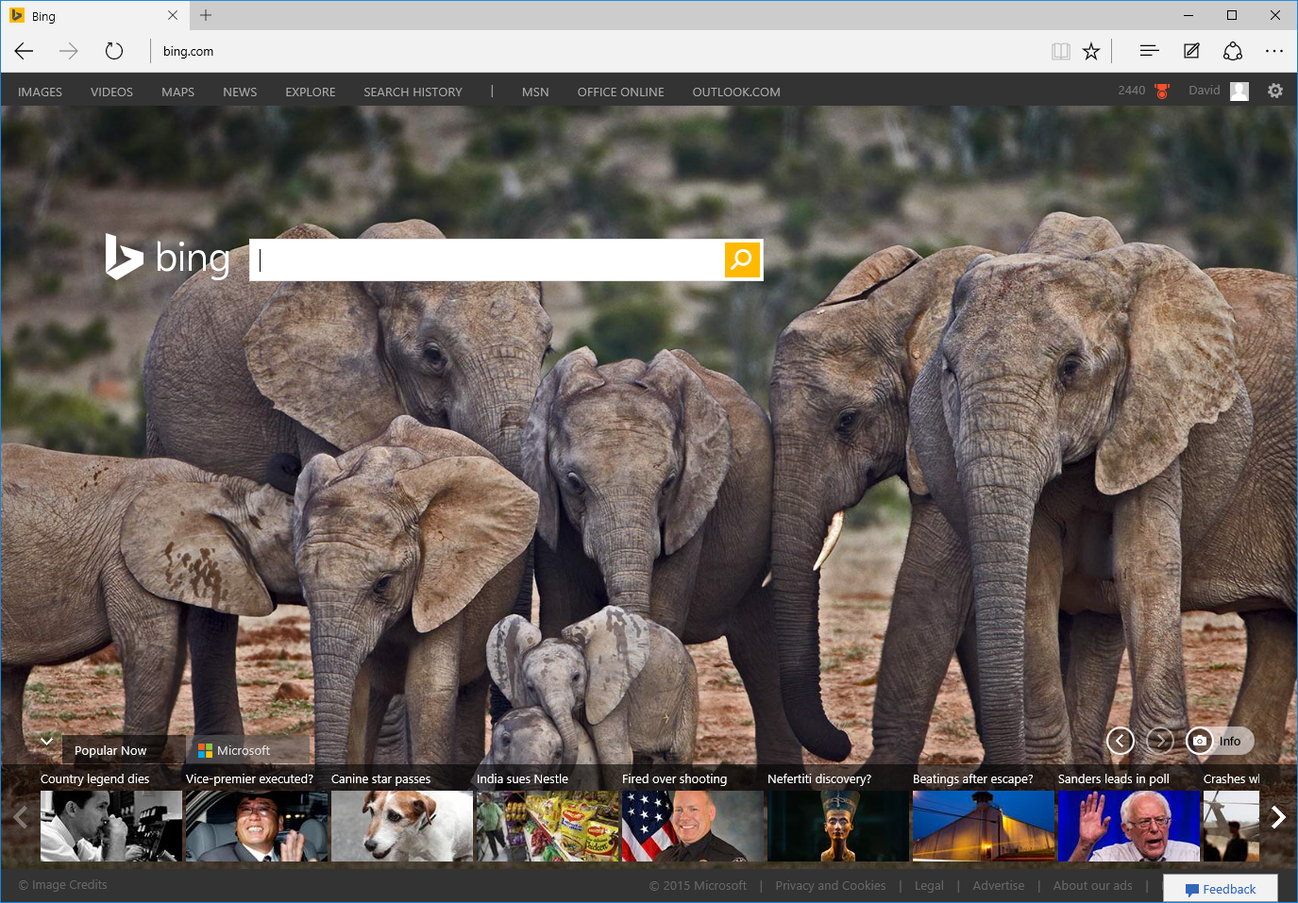
IntroducingMicrosoft Edge
Notes:
So now to the present day and the introduction of Microsoft Edge.

Slide 14

Always up-to-date
EdgeHTML
Chakra
EdgeHTML
Chakra
Notes:
The big difference with Microsoft Edge is that it has an engine that is always up to date.
IE11 will still be available for those cases where you need to access legacy web content, or for sites that use plug-ins such as ActiveX or Silverlight.
But for the modern web, for the most up to date features such as HTML5, ECMAScript 6 and CSS3 or 4, you’ll want to use Edge.
And we will always keep it up to date – we call it ‘Evergreen’.
So this makes things easier for the web developer. If you want to create a website, you just arget the latest versions of Firefox, Chrome and Edge

Slide 15
Performances

Slide 16
Performances

Slide 17
Security
App Container Sandbox
Web pages are rendered inside an app container, the latest and most secure client-side app sandbox in Windows
64bits by default
64-bit processes get significant security advantages by making Windows ASLR (Address Space Layout Randomization) stronger
MemGC
Memory Garbage Collector is a memory garbage collection system that defend the browser by taking responsibility for freeing memory away from the web developer

Slide 18




User-Agent Strings
Mozilla/5.0 (Windows NT 10.0; WOW64; rv:35.0) Gecko/20100101 Firefox/35.0
Mozilla/5.0 (Macintosh; Intel Mac OS X 10_10_1) AppleWebKit/600.1.25 (KHTML, like Gecko) Version/8.0 Safari/600.1.25
Mozilla/5.0 (Windows NT 10.0; WOW64) AppleWebKit/537.36 (KHTML, like Gecko) Chrome/40.0.2214.93 Safari/537.36
Mozilla/5.0 (Windows NT 10.0; WOW64) AppleWebKit/537.36 (KHTML, like Gecko) Chrome/39.0.2171.71 Safari/537.36 Edge/12.0

Slide 19
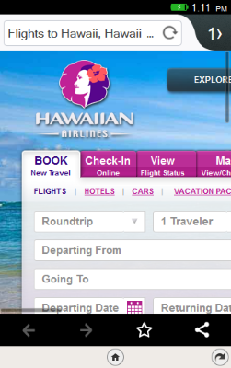
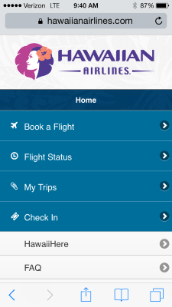



Slide 20
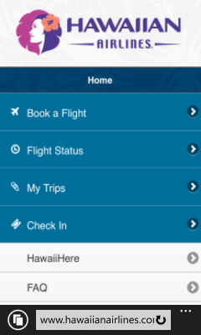


Slide 21
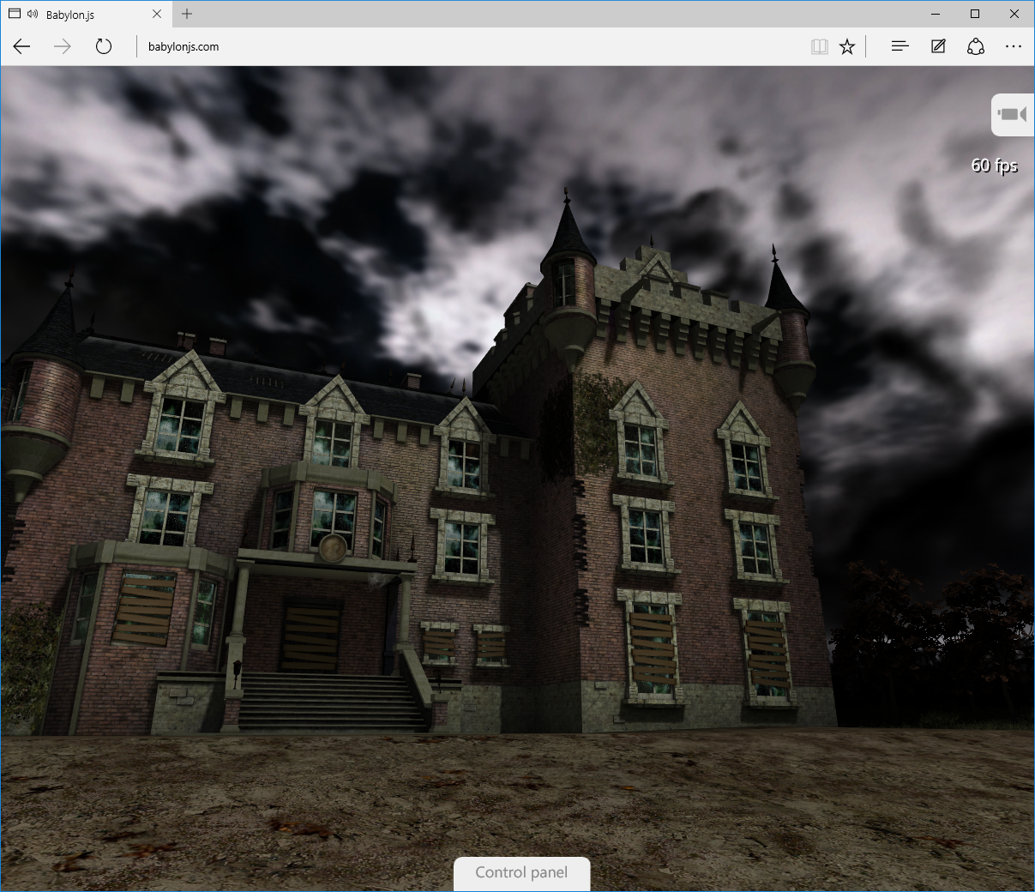
New features

Slide 22

Microsoft EdgeHTML
Microsoft Edge
JS Symbols
ES6 Numbers Built-Ins
DOM L3 XPath
Rest parameters
4200+ interoperability improvements
ES6 Template Strings
Arrow function
asm.js
JS iterators
<img srcset>
Web Audio API
ES6 classes
GamePad API
Content Security Policy
Video tracks
ES6 Promises
Selection API
ES6 Math Built-Ins
HTTP Strict Transport Security
Touch Events
Media Queries L4 Interaction Media
ES6 String Built-Ins
ES6 WeakSet
getUserMedia()
ES6 Spread
preserve-3d
ES6 Proxies
ES6 Object Built-Ins
HTTP/2
WAV audio
HTTP Live Streaming
Date <input> types
Motion JPEG
Generators

Slide 23
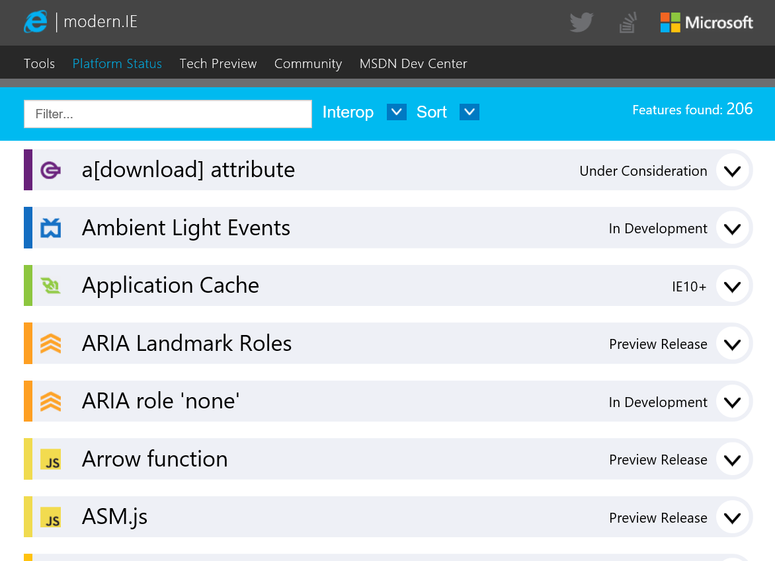
status.modern.ie

Slide 24
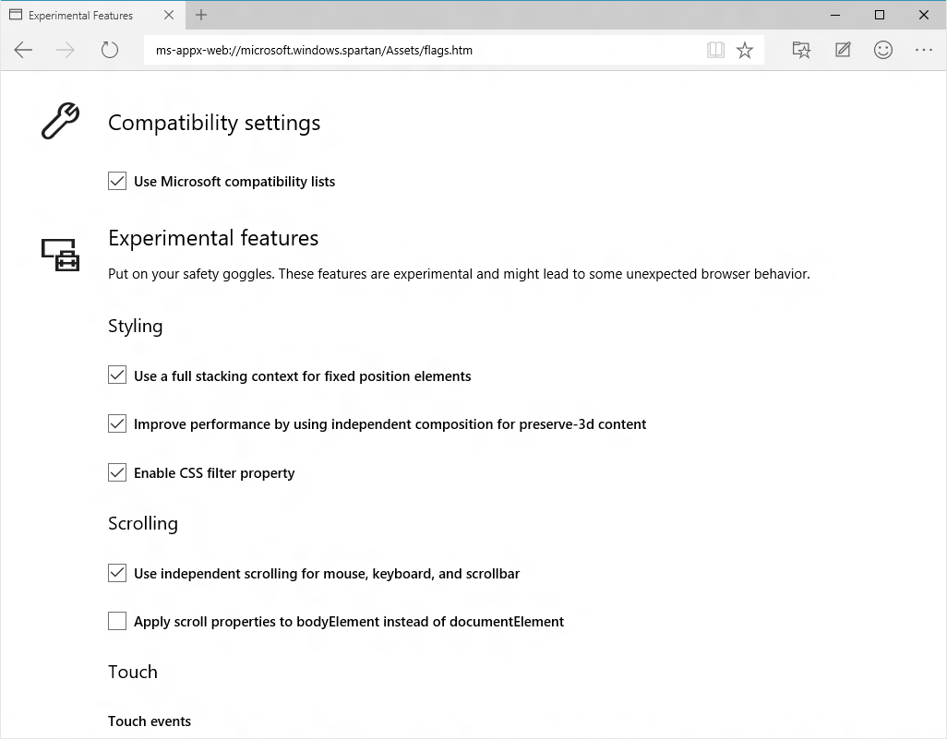
About:flags

Slide 25
Windows Web Platform

Slide 26
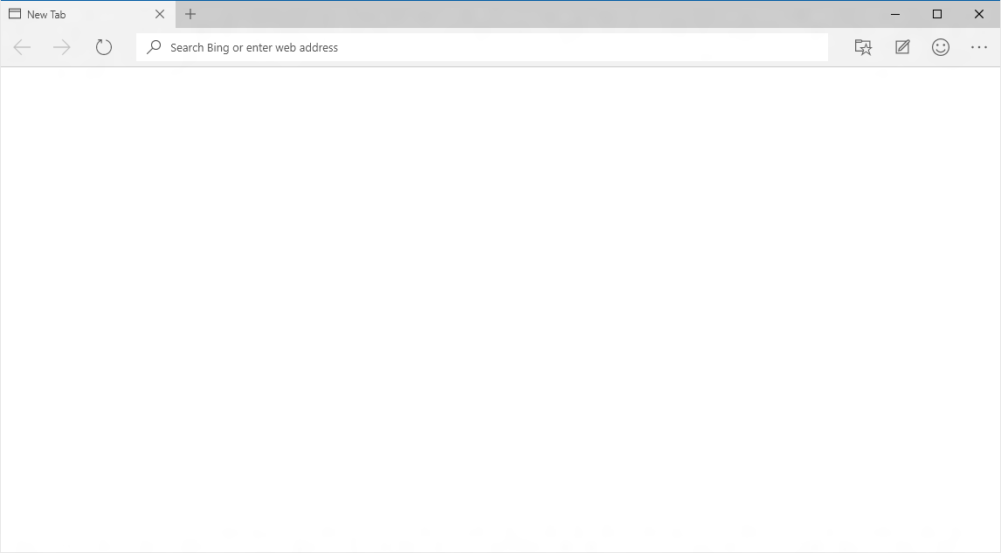
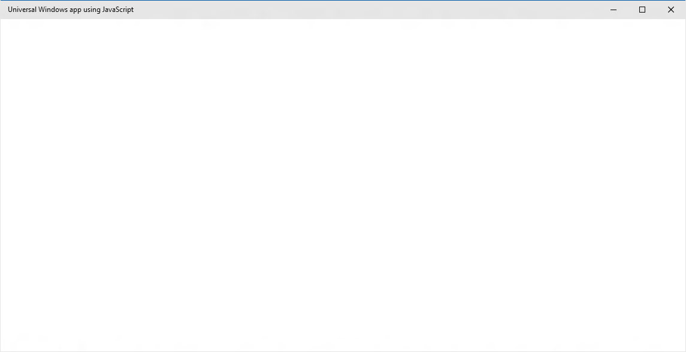
EdgeHTML.dll
Chakra
Packaged content
Offline first
Hosted content
Always up-to-date
WebView

Slide 27
Packaged content
Offline first

Slide 28
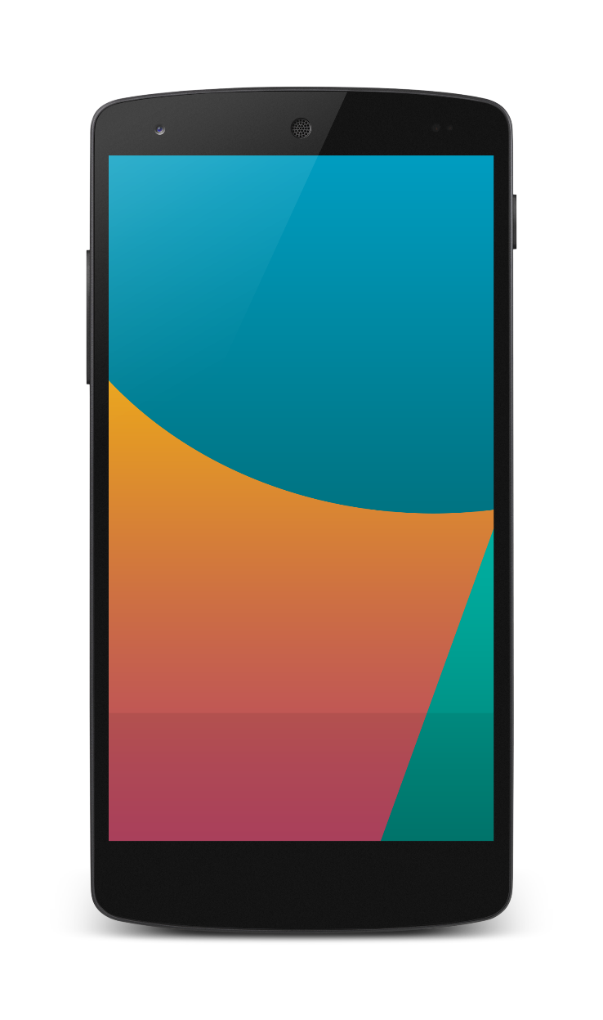
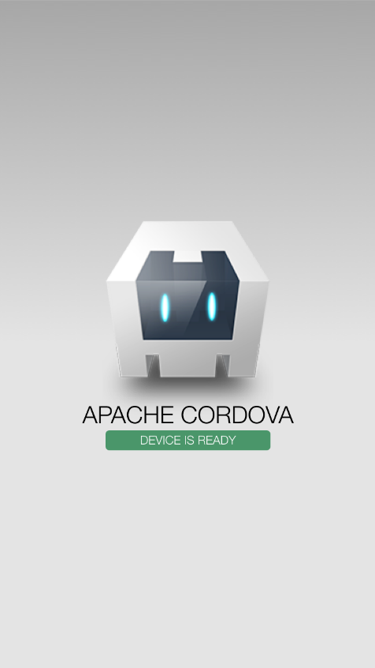

Packaged apps and tools investments
Build apps for iOS, Android & Windows
Nearly 100% shared code
Debug on any device or emulator
Use the JavaScript frameworks you love
Support for offline

Slide 29
WebView

Slide 30
WebView Control
Uses the always current Edge rendering engine
Improved app performance and responsiveness
Improved App to WebView communication
Enables Windows Runtime access

Slide 31
DEMO Webview

Slide 32
Hosted content
Always up-to-date

Slide 33
Microsoft Edge
NEW: Hosted Web Apps
Bring your website experience to the Windows Store
Leverage your web investments and developer workflow
Full access to Universal APIs like
Tiles, Notifications, Camera, Contact List, Calendar
.appx
HTML
CSS
JS
Universal Windows Platform

Slide 34
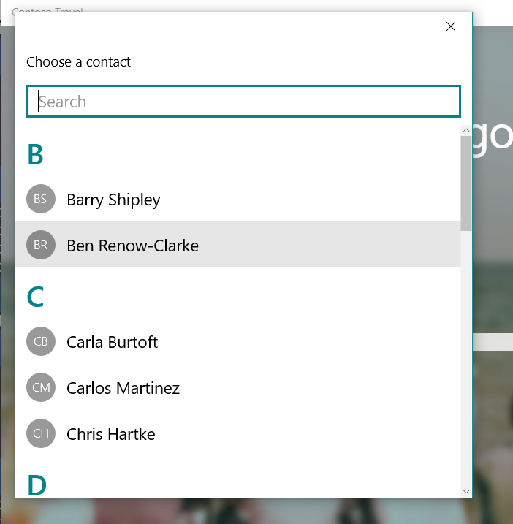
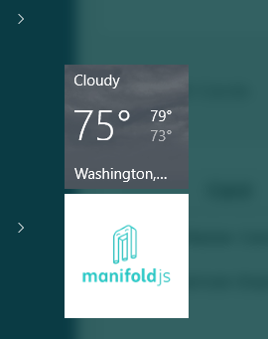
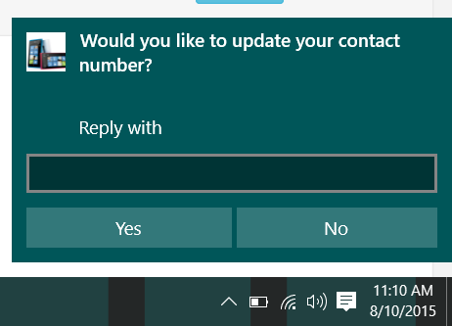
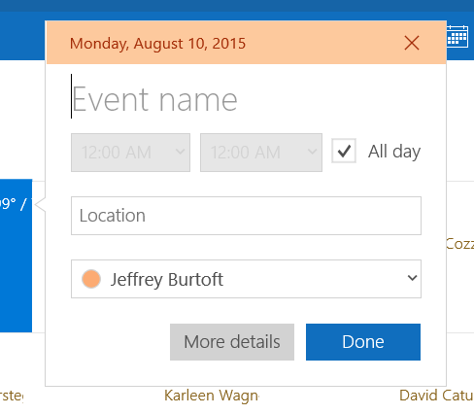
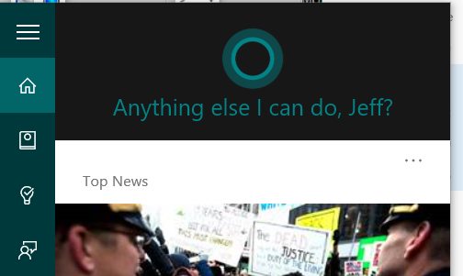
Windows APIs

Slide 35
DEMO Hosted Web App

Slide 36
W3C Standard
{
"name": "Super Web App",
"short_name": "SuperWA",
"start_url": "http://www.example.com",
"icons": [
{
"src": "tiny.png",
"sizes": "70x70"
},
{
"src": "square.png",
"sizes": "150x150"
},
{
"src": "apple-touch-icon-72x72-precomposed.png",
"sizes": "72x72"
},
{
"src": "niceicon.png",
"sizes": "128x128"
}
],
"display": "standalone",
"orientation": "landscape"
}
Manifest for Web Apps
http://w3c.github.io/manifest/

Slide 37
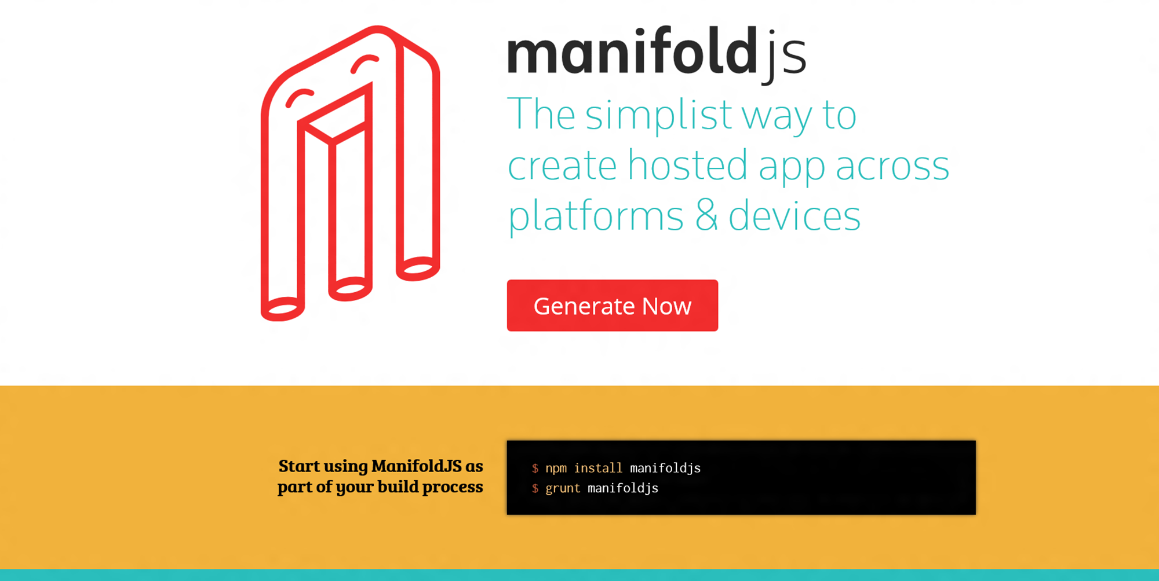

Slide 38
DEMO ManifoldJS

Slide 39
Going further….
Microsoft Edge: dev.modern.ie
Web App Platform: http://dev.windows.com
Cordova: aka.ms/cordova
Manifoldjs: www.manifoldjs.com
Project Westminster: http://blogs.windows.com/buildingapps/2015/07/06/project-westminster-in-a-nutshell/

Slide 40
Thank you! Questions ?

